Slide 1

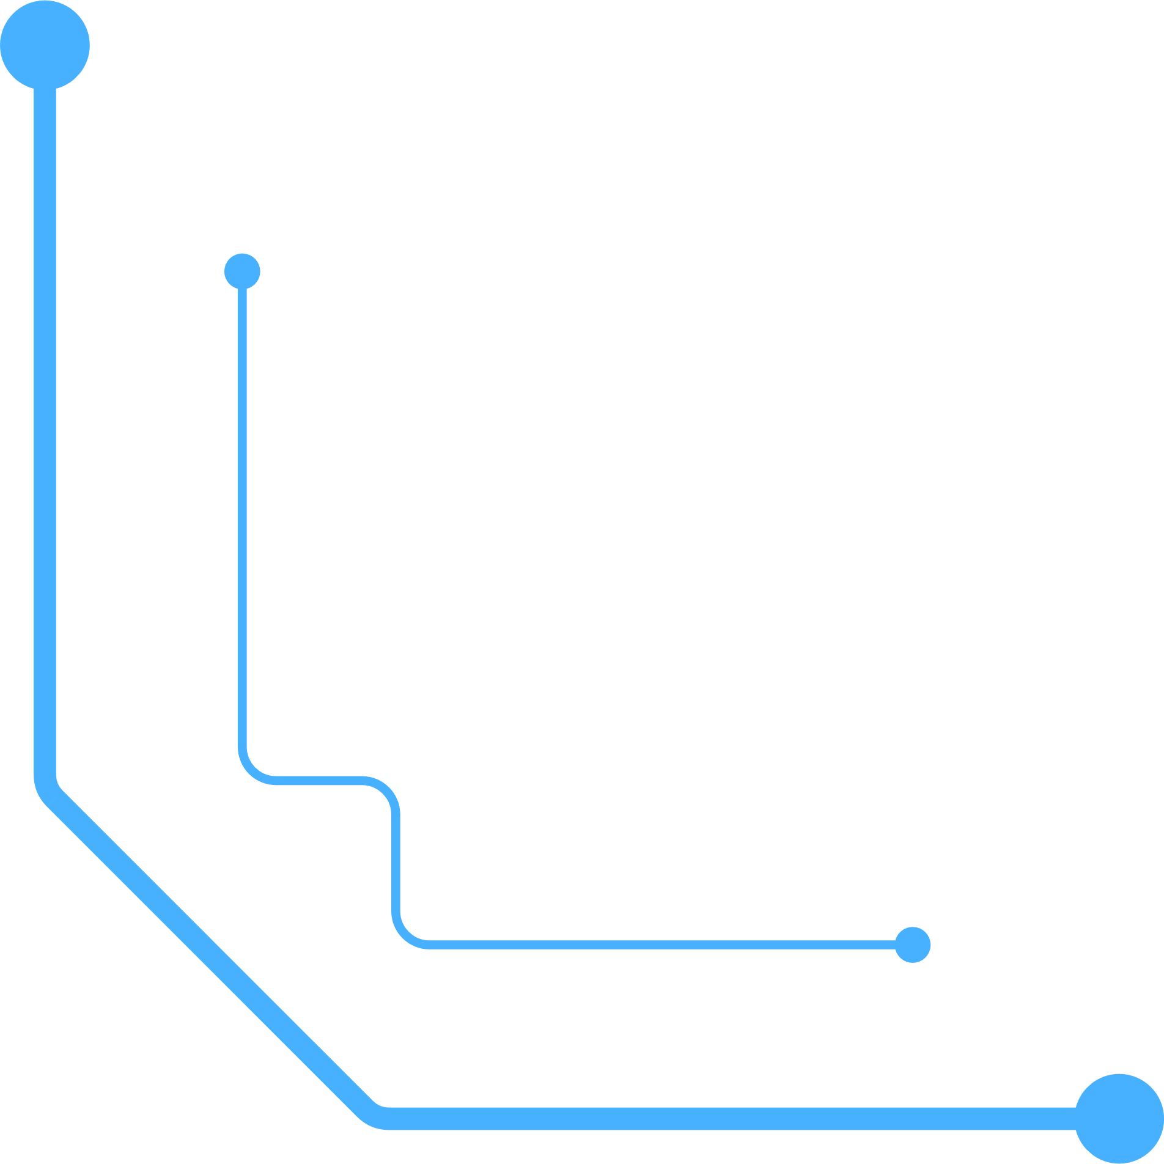
Input/output Interface through
8237 (DMA Controller)
An overview of DMA functionality, architecture, and applications
Presented by Istiak Alam
Batch : CSE-20
ID : 0692230005101005
1

Slide 2
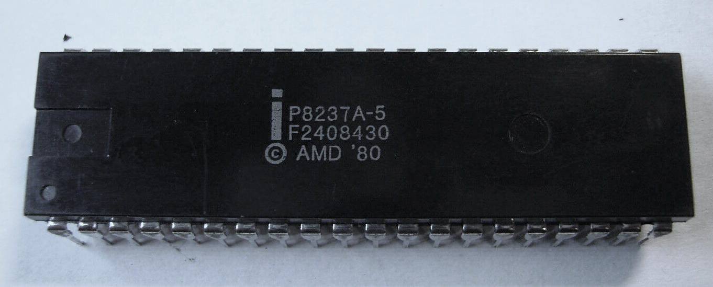
Introduction to 8237 DMA Controller
The 8237 DMA (Direct Memory Access) Controller is an Intel-designed chip that enables direct data transfer between memory and peripherals without CPU intervention, optimizing performance in systems that need fast data processing. It’s commonly used in computer systems to improve the efficiency of data-intensive tasks, such as reading from or writing to disks, memory-to-memory transfers, or graphics operations.
Direct Memory Access (DMA) is a method of
allowing data to be moved from one location to
another in a computer without intervention from
the central processor (CPU)
Fig 1 : 8237 DMA controller
2

Slide 3
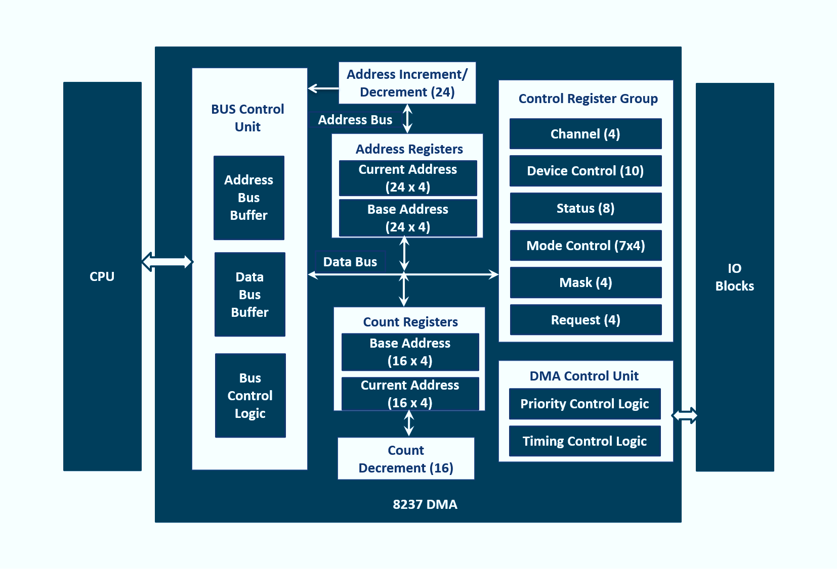
8237 DMA Architecture Overview
Address Register: Holds the address of the data block in memory.
Channel Registers: Hold the address and count for each channel
Control Logic: Manages the flow of data transfer.
Status and Command Registers: For configuration and status feedback.
Fig 2 : System Interface of 8237
3

Slide 4
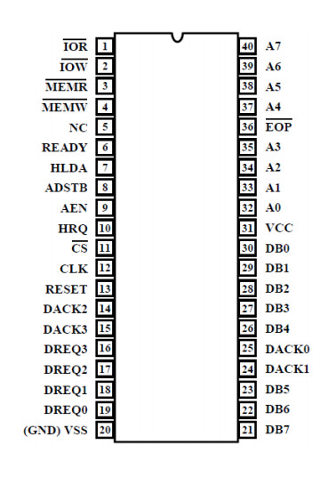
Pin Configuration of the
8237 DMA Controller
I/O read and write signals.
Memory read and write signals.
Address inputs for selecting internal registers.
Hold Request and Hold Acknowledge for CPU.
8237 DMAC
DMA Acknowledge outputs
DMA Request inputs for channels 0–3.
Fig 3 : Pin Configuration
4

Slide 5
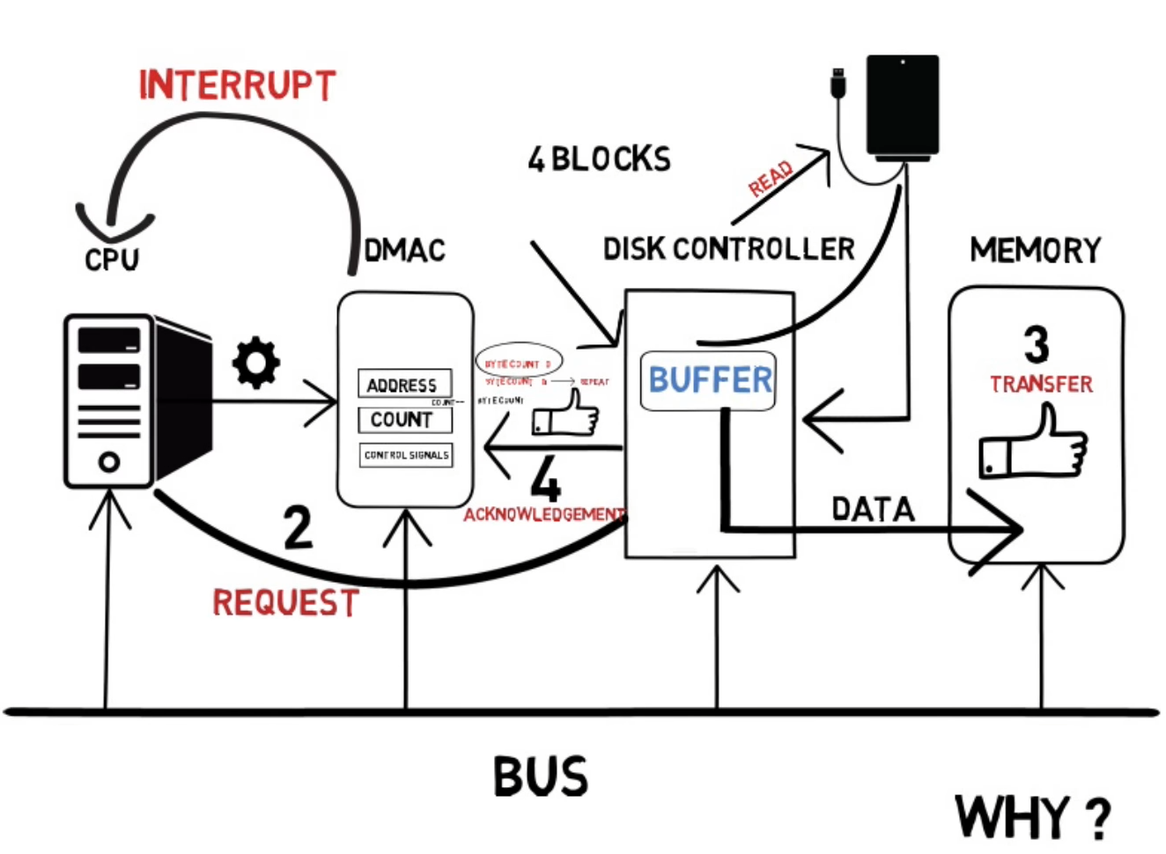


Working of 8237 DMA Controller
Peripheral sends a DREQ (DMA request) signal.
8237 sends HRQ (Hold Request) to the CPU.
CPU responds with HLDA (Hold Acknowledge).
Data transfer begins between memory and peripheral.
8237 releases control back to the CPU once data transfer is complete
Fig 4 : working process
5

Slide 6
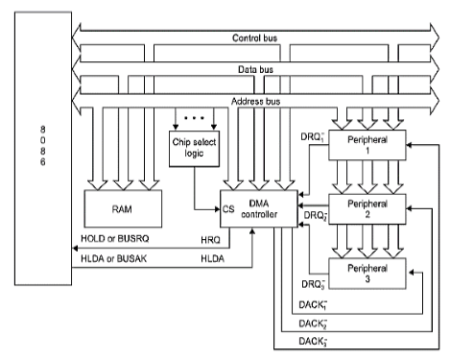
Interface DMA controller 8237 with 8086
1. Bus Control Signals (HRQ and HLDA):
The 8237 uses HRQ (Hold Request) to request control of the system bus from the 8086. In response, the 8086 issues HLDA (Hold Acknowledge) to grant bus control, allowing the 8237 to access memory directly without CPU involvement.
2. Address and Data Bus:
The address bus and data bus are shared between the 8086 and the 8237. The 8237 uses these buses to access specific memory locations where data needs to be read or written.
3. Control Signals:
MEMR (Memory Read) and MEMW (Memory Write) Used by the 8237 to signal memory read or write operations. IOR (I/O Read) and IOW (I/O Write) Used to read from or write to peripheral devices.
4. DMA Channels:
The 8237 has four DMA channels (DREQ0–DREQ3), each capable of handling independent data transfer requests from connected peripherals. Each channel has an associated DACK (DMA Acknowledge) signal, which is sent back to the requesting device to confirm data transfer.
5. Interrupt Handling:
Once the data transfer is complete, the 8237 can signal the 8086 via an interrupt to indicate that the DMA operation is finished, allowing the CPU to regain control of the bus.
Fig 5 : Interfacing with 8086
6

Slide 7
Modes of Operation
There are 4 Modes in 8237 DMA Controller :
Single Transfer Mode:- Transfers one byte at a time.
Block Transfer Mode:- Transfers entire blocks of data.
Demand Transfer Mode:- Transfer as long as the peripheral requests.
Cascade Mode:- Supports multiple 8237 controllers.
7

Slide 8
Applications of 8237 DMA Controller
Disk drive Controller
Graphics and Video Processing
Audio Processing
Network Interface Controllers (NICs)
Printers and Scanners
Real-Time Embedded Systems
Memory-to-Memory Data Transfers
Multimedia Systems
Data Acquisition Systems
Communication Systems
8

Slide 9
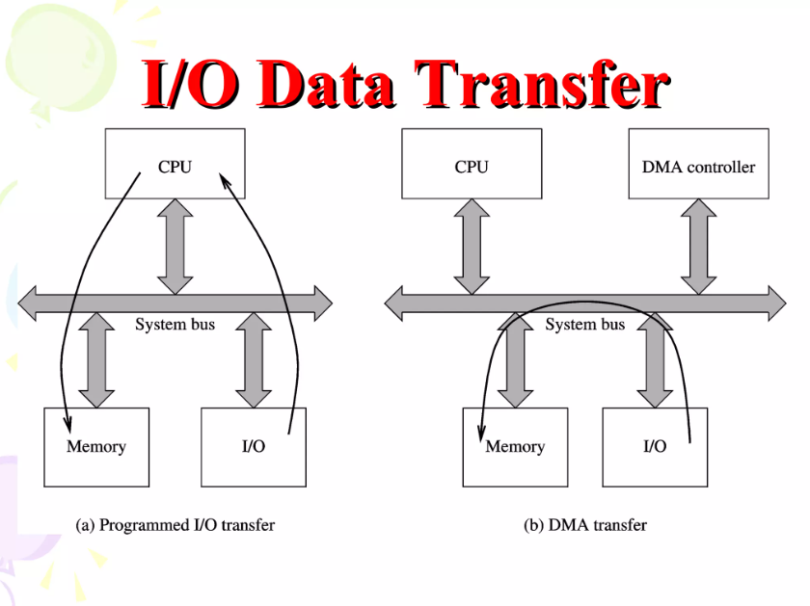
Advantages of Using 8237 DMA Controller
Reduced CPU Load
Increased Data Transfer Speed
Multiple Transfer Modes
Large data Transfer
Multichannel Support
Reduced Latency in I/O Operations
Improved System Performance
Energy Efficiency
Fig 6 : Compare with CPU
9

Slide 10
Features of INTEL 8237 DMA
Enable/Disable Control of Individual DMA Requests
Four Independent DMA Channels
Independent Auto initialization of All Channels
Memory-to-Memory Transfers
Memory Block Initialization
Address Increment or Decrement
High Performance: Transfers up to 1.6M Bytes/Second
with 5 MHz 8237A-5
Software DMA Requests
End of Process Input for Terminating Transfers
10

Slide 11
CONCLUSION
In conclusion, the 8237 DMA Controller is an essential component in efficient data transfer and I/O operations, allowing direct memory access by peripherals without constant CPU intervention. With its multichannel support, flexible transfer modes, and ability to handle large data volumes, the 8237 significantly enhances system performance, reduces CPU load, and enables multitasking in complex applications. Its use in multimedia, real-time systems, and data-heavy applications highlights its versatility and importance in modern computing and embedded systems. The 8237’s advantages make it an invaluable tool in achieving high-speed, efficient data processing.
11

Slide 12
THANK YOU
Reference :
1.
2.
3.
edutechlearners
geeksforgeeks
https://www.ques10.com/p/13450/interface-dma-controller-8237-with-8086-micropro-1/
12

